Slide 1

Forecasting COVID-19 cases using SARS-Cov2 Titers in Urban Wastewater
CS-109B: Group #111
Spring 2021
TEAM
Vivek Bhatia
Prakash Bhatt
Lalitanjali Bondili
Raghu Soori

Slide 2
CONTENTS
Background
Datasets
Exploratory Data Analysis
Models Selection
Model Evaluation
Conclusion & Next Steps
Final Project Group #111 V Bhatia, P Bhatt, L Bondili, R Soori
2

Slide 3
Background
Since the start of the SARS-CoV-2 (COVID-19) pandemic, an accurate count of cases in the community is tracked by symptomatically and clinically diagnosed cases.
This method has inherent drawback as many of the patients do not report the disease and/or maybe asymptomatic [1].
Studies have shown proof of gastro-intestinal disorders triggered by SARS-CoV-2 infections in patients and the occurrence of viral RNA in community wastewater plants [2].
Wastewater-based epidemiological surveillance can be used as an early warning system for disease outbreak and to forecast the rate of transmission in communities.
We intend to explore the relationship between SARS-CoV-2 titers in urban wastewater and the rate of infections in nearby communities and design models to forecast the rate of infections using titer information as proxy data (a.k.a Nowcasting).
[1] Wu et al. SARS-CoV-2 titers in wastewater foreshadow dynamics and clinical presentation of new COVID-19 cases (202)
[2] Xiao et al. Evidence for gastrointestinal infection of SARS-CoV-2 (2020)
Final Project Group #111 V Bhatia, P Bhatt, L Bondili, R Soori
3

Slide 4
DATASETS

Slide 5
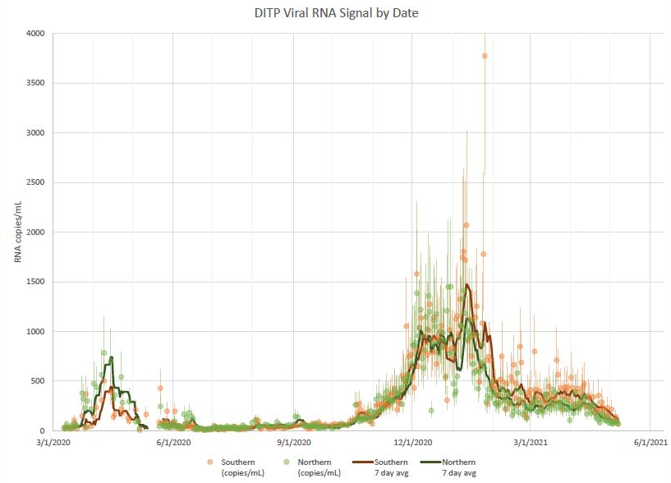
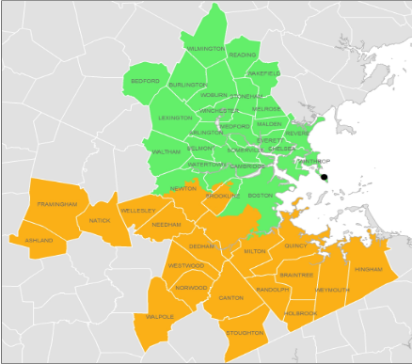
Dataset
MWRA Wastewater COVID-19 Tracking Data - Collected by Massachusetts Water Resources Authority measuring the quantity of SARS-CoV-2 viral RNA samples in sewage wastewater for Boston’s Southern and Northern districts
Figure: Northern (Green) and Southern (Orange) Boston Districts
Figure: Viral RNA collection data over time in Boston Counties
Source: https://www.mwra.com/biobot/biobotdata.htm
Final Project Group #111 V Bhatia, P Bhatt, L Bondili, R Soori
5

Slide 6
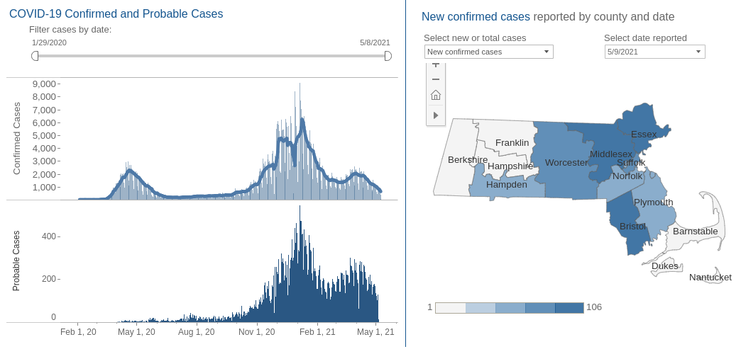
Dataset
Massachusetts official COVID-19 Case Count: Publicly available dataset provided by the Massachusetts Department of Public Health
Source: https://www.mass.gov/info-details/covid-19-response-reporting#covid-19-interactive-data-dashboard-
Final Project Group #111 V Bhatia, P Bhatt, L Bondili, R Soori
6

Slide 7
EXPLORATORY DATA ANALYSIS

Slide 8
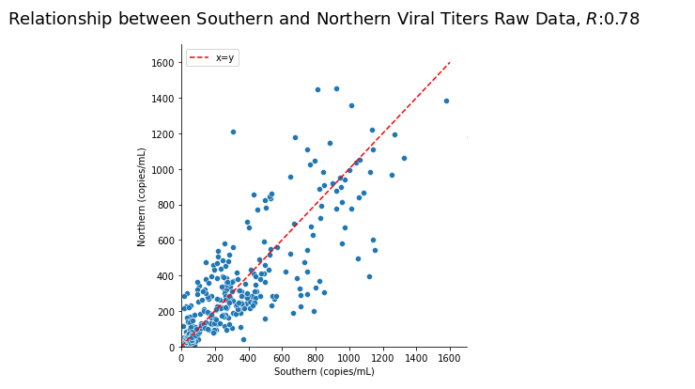
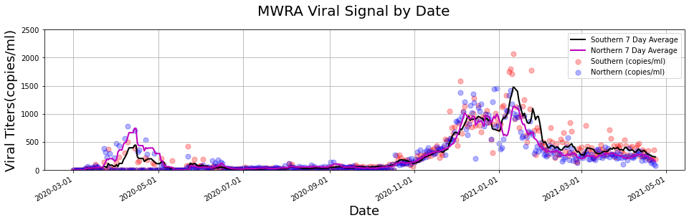
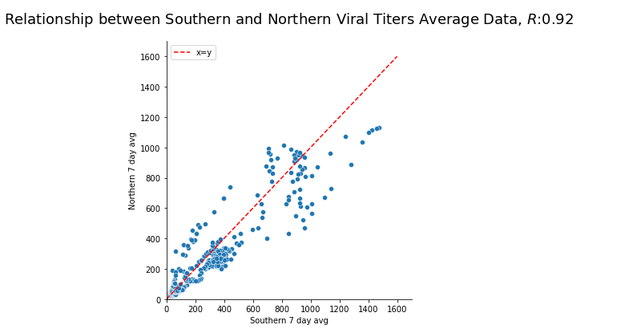
Exploratory Data Analysis – MWRA
TAKE AWAYS
Raw daily values are noisy and show a lot of variability, the 7 day rolling average is much smoother and should work well as the input predictors
Strong linear relationship between Southern and Northern titer 7 day average values
Final Project Group #111 V Bhatia, P Bhatt, L Bondili, R Soori
8

Slide 9
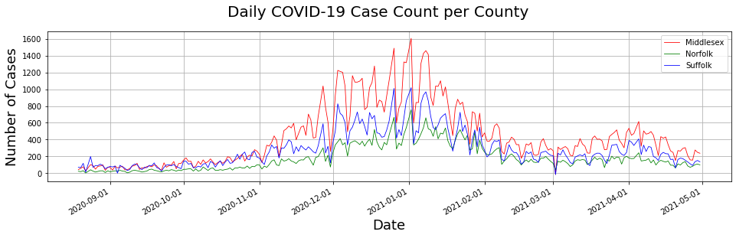
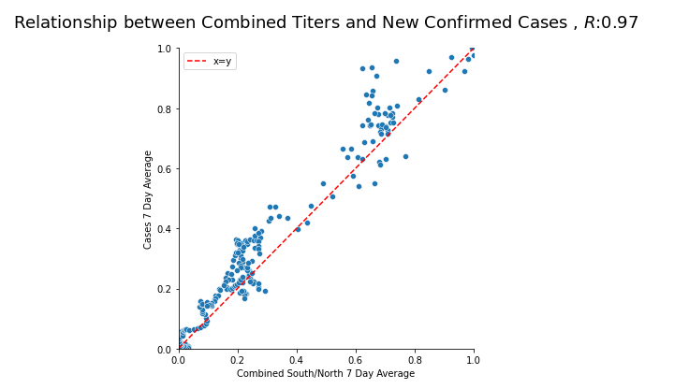
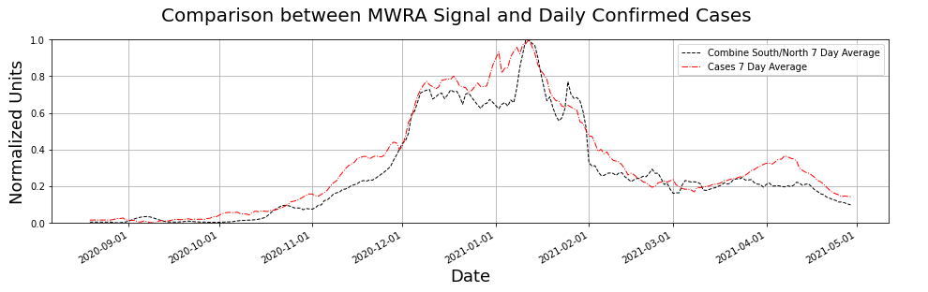
Exploratory Data Analysis – MASS COVID-19 Data
TAKE AWAY
Daily case count for Massachusetts is also noisy and shows seasonal variations with a window of 7-10 days.
7 Day rolling Average of confirmed cases count shows strong linear relationship with both Southern and Northern Titer Average Values.
Final Project Group #111 V Bhatia, P Bhatt, L Bondili, R Soori
9

Slide 10
Dataset Preprocessing
MWRA Wastewater Dataset:
Missing values in the dataset were imputed using ‘ARIMA’ forecasts.
Since raw values were noisy, we computed a 7 day rolling average for use as predictor variables.
MASS COVID-19 Case Count:
Daily case count is available for Massachusetts on a per county level, however, since our waste water RNA signal is combined into Southern and Northern Boston districts, we combine the three counties of Middlesex, Norfolk and Suffolk to get a combined case count for Greater Boston Area.
Since raw values were noisy, we computed a 7 day rolling average for use the response variable.
Missing values in the dataset were imputed using ‘ARIMA’ forecasts.
Alignment:
Time Range for the datasets were aligned to only consider the intersection of dates where both MWRA Signal and Daily Case Counts were available (08/2020 – 05/2021)
Normalization:
Dataset was normalized to values between [0,1] to allow for standardized comparison scale for neural networks and linear regression models alike.
Final Project Group #111 V Bhatia, P Bhatt, L Bondili, R Soori
10
Notes:
Now coming to data processing,
Our target variable has different interpretations for positive and negative values.
so we used an absolute value where lower number would indicate high mortality risk and higher number would indicate lower risk.
For identifying race, we used the distribution of race in 70s and for sex, we leveraged the fact that males and females have different ranges for some of the clinical variables like RBC.
For filling in the missing data in our dataset, we used an iterative imputer.
We added some new flags indicating predictors outside of normal range. e.g. if a person had high BMI, we would either flag it as 1 or 2 depending on the range and then used a sum_flag that would add up these flags to indicate an overall health of a person.
25

Slide 11
MODEL SELECTION
Final Project Group #111 V Bhatia, P Bhatt, L Bondili, R Soori
11
Notes:
Now coming to data processing,
Our target variable has different interpretations for positive and negative values.
so we used an absolute value where lower number would indicate high mortality risk and higher number would indicate lower risk.
For identifying race, we used the distribution of race in 70s and for sex, we leveraged the fact that males and females have different ranges for some of the clinical variables like RBC.
For filling in the missing data in our dataset, we used an iterative imputer.
We added some new flags indicating predictors outside of normal range. e.g. if a person had high BMI, we would either flag it as 1 or 2 depending on the range and then used a sum_flag that would add up these flags to indicate an overall health of a person.
25

Slide 12
Model Selection
Given the strong linear relationship between the titer average values and the confirmed daily case count average values, we suspect linear regression models might work best for this problem.
Final Project Group #111 V Bhatia, P Bhatt, L Bondili, R Soori
12
Notes:
Now coming to data processing,
Our target variable has different interpretations for positive and negative values.
so we used an absolute value where lower number would indicate high mortality risk and higher number would indicate lower risk.
For identifying race, we used the distribution of race in 70s and for sex, we leveraged the fact that males and females have different ranges for some of the clinical variables like RBC.
For filling in the missing data in our dataset, we used an iterative imputer.
We added some new flags indicating predictors outside of normal range. e.g. if a person had high BMI, we would either flag it as 1 or 2 depending on the range and then used a sum_flag that would add up these flags to indicate an overall health of a person.
<number>

Slide 13
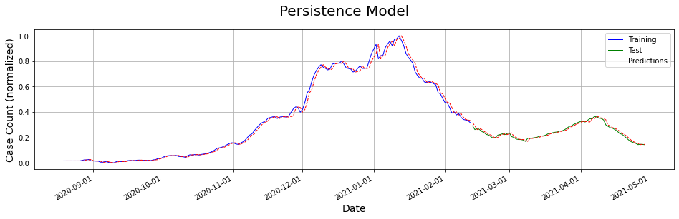
Phrase this better
Models Explored: Persistence Model
TAKE AWAY
TAKE AWAY
The persistence model considers that the Covid Case Count at t + 1 is equal to the Covid Case Count at t.
We use the persistence model and assume that there is a relation between the average of last 7 covid case values and the next response variable.
Final Project Group #111 V Bhatia, P Bhatt, L Bondili, R Soori
13

Slide 14
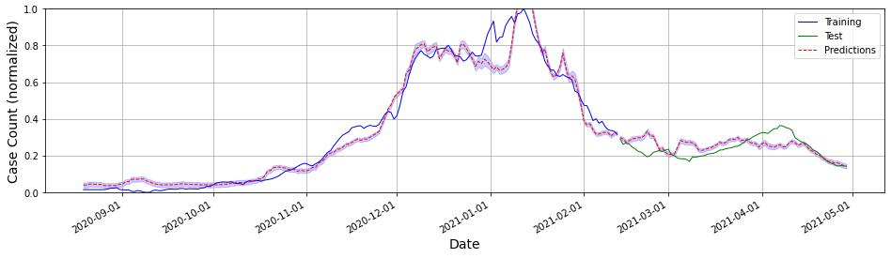
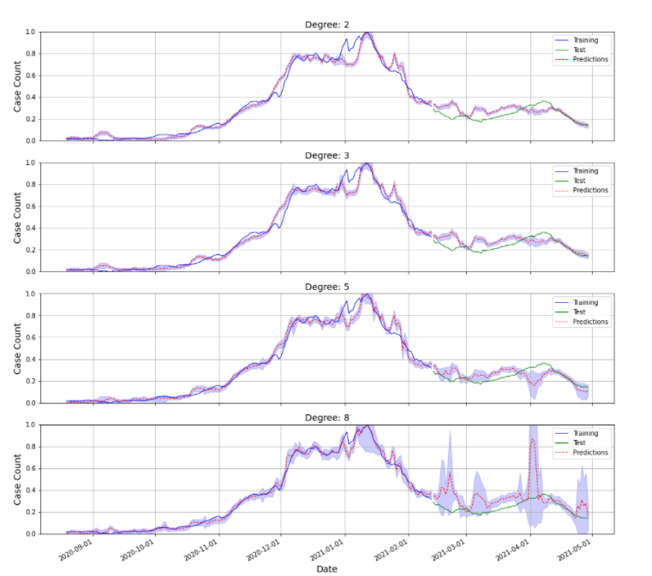
Models Explored: Linear and Polynomial Regression
Linear Regression
Polynomial Regression
TAKE AWAY
Increase in polynomial degree increases the variance in predicted values which is a result of overfitting
Linear Regression performed better with respect to the polynomial regression models
Final Project Group #111 V Bhatia, P Bhatt, L Bondili, R Soori
14

Slide 15
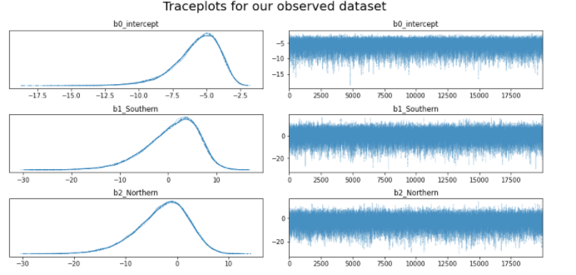
Vivek, please update this slide.
Models Explored: GLM Poisson
Slide for GLM Poisson
TAKE AWAY
Point 1
Point 2
Final Project Group #111 V Bhatia, P Bhatt, L Bondili, R Soori
15

Slide 16
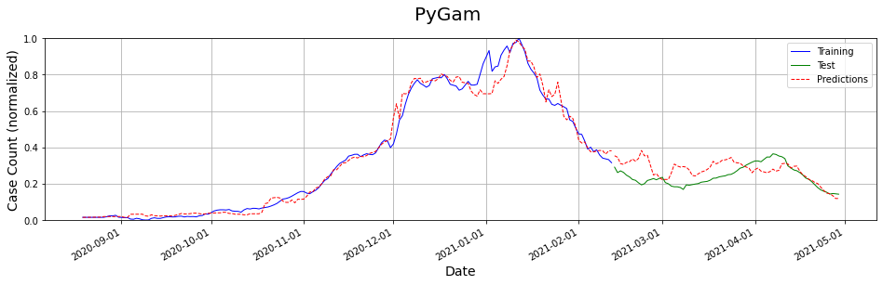
Vivek to update this slide
Models Explored: PyGAM
Slide for PyGAM
TAKE AWAY
Point 1
Point 2
Final Project Group #111 V Bhatia, P Bhatt, L Bondili, R Soori
16

Slide 17
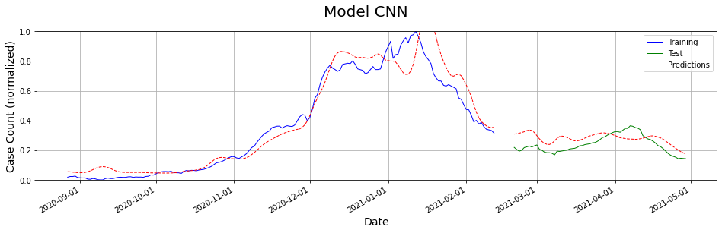
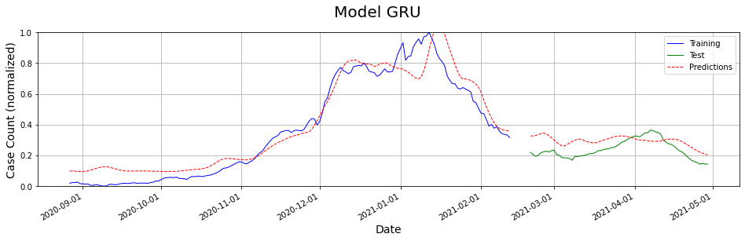
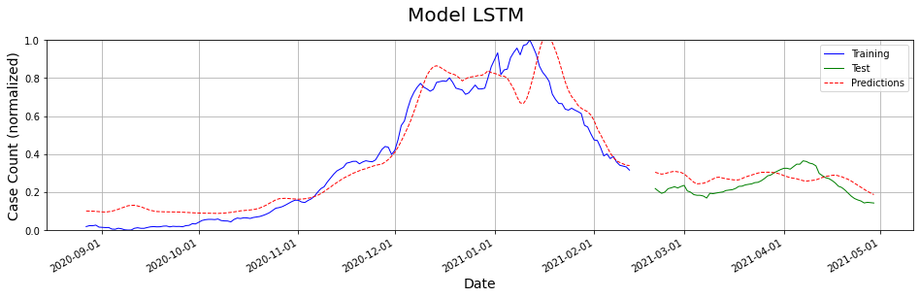
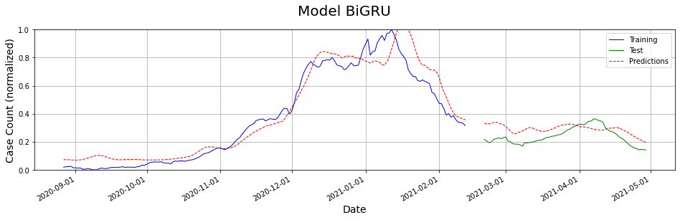
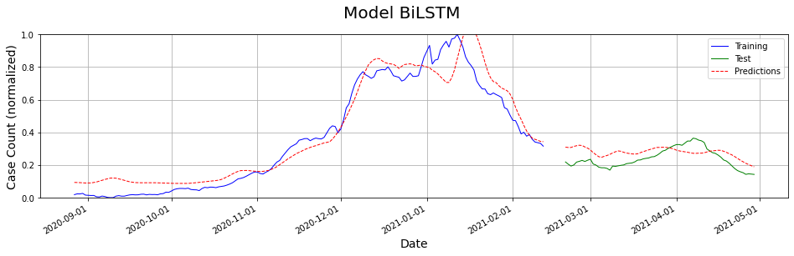
Update graphs with better results if any
Models Explored: Deep Learning Models
TAKE AWAY
All the deep learning models provided very similar results
The predicted values are lagged by 5-6 days when compared to the train and test set
Final Project Group #111 V Bhatia, P Bhatt, L Bondili, R Soori
17

Slide 18
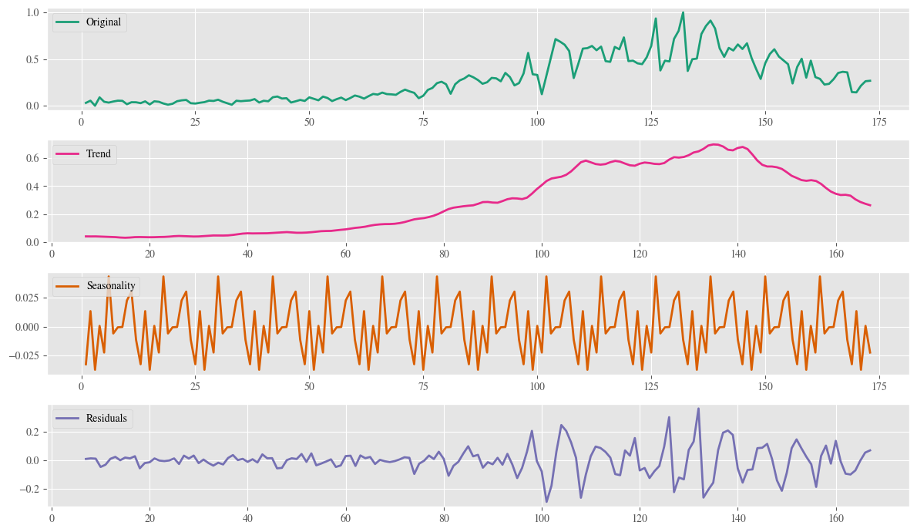
Models Explored: Time Series Analysis
TAKE AWAY
On decomposing the training data into trend, seasonality and residuals, we see that there is seasonality in the data
This encouraged us to split the data variable into day-of-week, day-of-month and month and investigate the models further
Final Project Group #111 V Bhatia, P Bhatt, L Bondili, R Soori
18

Slide 19
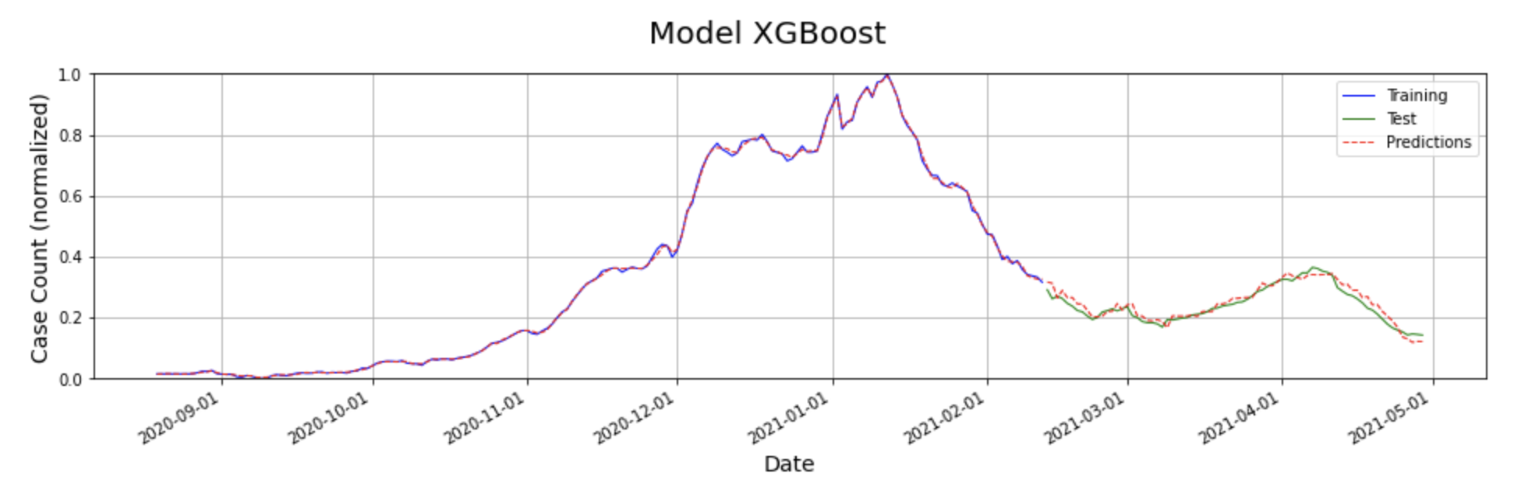
Models Explored: XGBoost
TAKE AWAY
The model predicts the training and test data with better precision when compared to the other models.
Accounting for seasonality by incorporating multiple date related variables has resulted in better predictive capabilities of the model
Final Project Group #111 V Bhatia, P Bhatt, L Bondili, R Soori
19

Slide 20
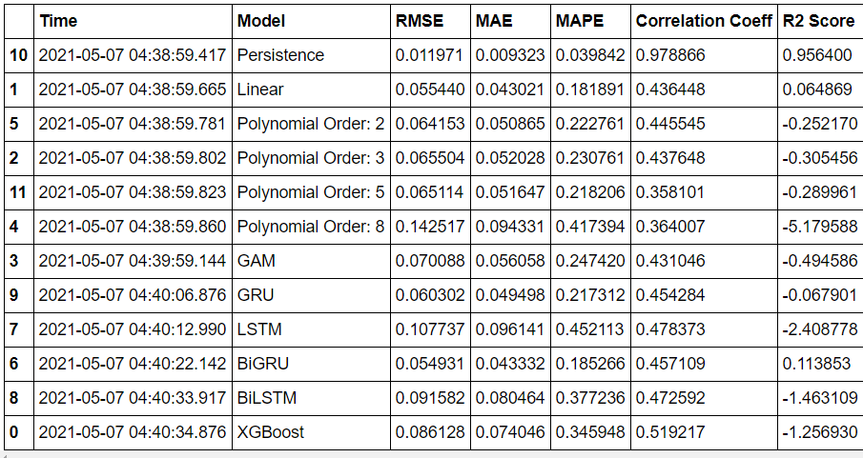
Run all models and update output
Models Explored
TAKE AWAY
Since this is a regression problem with a strong underlying linear relationship, RMSE, MAE and MAPE have been used to compare models.
While persistence model has performed very well, XGBoost is a close second with a low RMSE of 0.01.
The R-Squared values of Persistence, XGBoost and CNN are highly positive indicating that the predictor variables have been able to explain the variance in the response variable well.
Final Project Group #111 V Bhatia, P Bhatt, L Bondili, R Soori
20

Slide 21
Conclusion
Adding the output of the persistence model as an input variable has improved the predictive capabilities of all models. This shows that there is a significant relation between covid cases counts of the future and the past. We have predicted a particular day’s case count using the previous day’s case count.
RMSE, MAE and MAPE have been used as the metrics to compare models.
Time series decomposition of the training data shows that there could be an underlying seasonal factor in the data. We accounted for this by splitting the date variable into day-of-month and day-of-week.
Final Project Group #111 V Bhatia, P Bhatt, L Bondili, R Soori
21

Slide 22
References and Special Thanks
Wu et al. SARS-CoV-2 titers in wastewater foreshadow dynamics and clinical presentation of new COVID-19 cases (2020 doi: https://doi.org/10.1101/2020.06.15.20117747)
https://www.mwra.com/biobot/biobotdata.htm
https://www.mass.gov/info-details/covid-19-response-reporting#covid-19-interactive-data-dashboard-
Yang et al. Accurate estimation of influenza epidemics using Google search data via ARGO (2015, https://doi.org/10.1073/pnas.1515373112)
Special Thanks
We would like to say special thanks to
Dr. Mauricio Santillana,
TF of the 109b – Prof Protopapas, Glickman, Tanner
Teaching Assistants
Final Project Group #111 V Bhatia, P Bhatt, L Bondili, R Soori
22

Slide 23
THANK YOU
Final Project Group #111 V Bhatia, P Bhatt, L Bondili, R Soori
23

Slide 24
BACKUP SLIDES

Slide 25
Project Proposal
We intend to explore and establish the relationship between wastewater surveillance data collected and maintained by the Massachusetts Water Resources Authority, and the outbreak of COVID-19 in the neighboring communities.
We used supervised learning techniques to develop models which can closely predict the current count of COVID-19 cases in the community using solely the data available from wastewater viral titers
Final Project Group #111 V Bhatia, P Bhatt, L Bondili, R Soori
25

